Slide 1
A Parallel Algorithm Template for Updating Single-Source Shortest Paths in Large-Scale Dynamic Networks
22i-0961 Hamza Naveed
22i-1042 Maaz Ali
22i-1052 Huzaifa Nasir

Slide 2
Agenda
Introduction
Proposed Solution
Approach
Parallelization strategies
Results from Research paper
Conclusion

Slide 3

Dynamic Graphs & SSSP

Slide 4
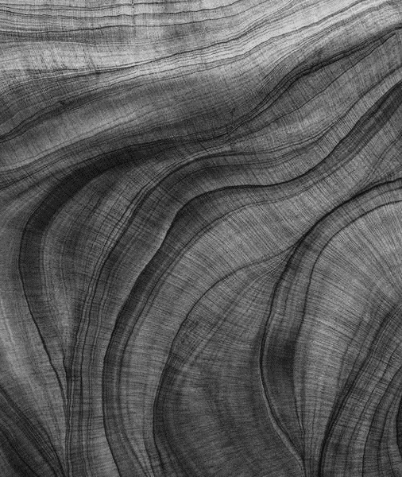
Introduction
What is Single Source Shortest Path (SSSP)?
Finds shortest path form source to vertices.
Used in routing, navigation etc.
Challenges in Dynamic Network
Graphs with changing edges over time.
Recomputing SSSP every time is inconvenient.

Slide 5


Slide 6
Proposed Solution
Overview
Parallel algorithm template for updating SSSP.
Updates only affected parts of the graph.
Key Idea
Two-step process:
Identify affected subgraphs.
Update affected subgraphs to form new SSSP tree.

Slide 7
Data Structures
SSSP Tree:
Stored as adjacency list.
Vertex Attributes:
Parent
Dist : Distance from source
Affected Del: Flag for deletion.
Affected: Flag for general effects.

Slide 8
Handling Edge Changes
Deletions:
If edge in SSSP tree:
Set Dist[v] = ∞
Set Parent[v] =NULL
Mark Affected Del[v] and Affected[v]
Insertions:
If Dist[u] + W(u,v) < Dist[v]
Update Dist[v] , Parent[v]
Mark Affected[v]

Slide 9
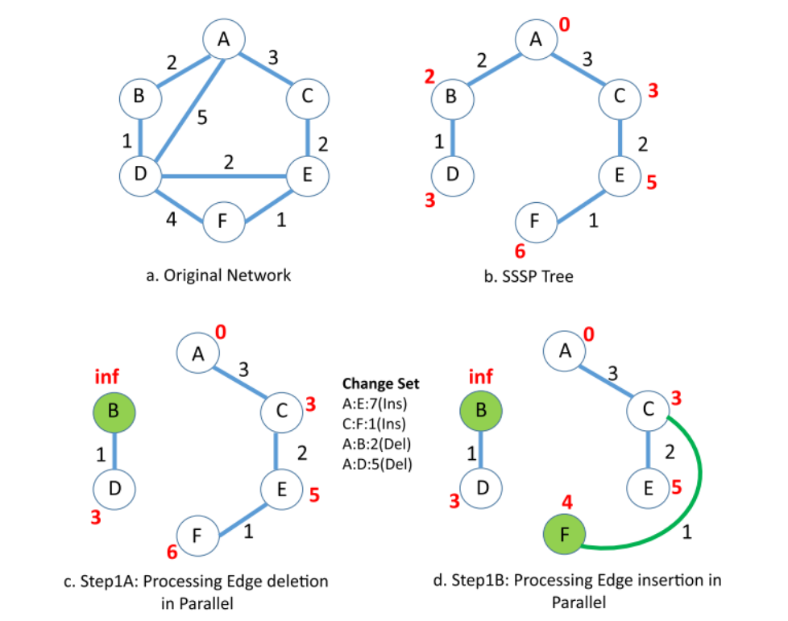

Slide 10
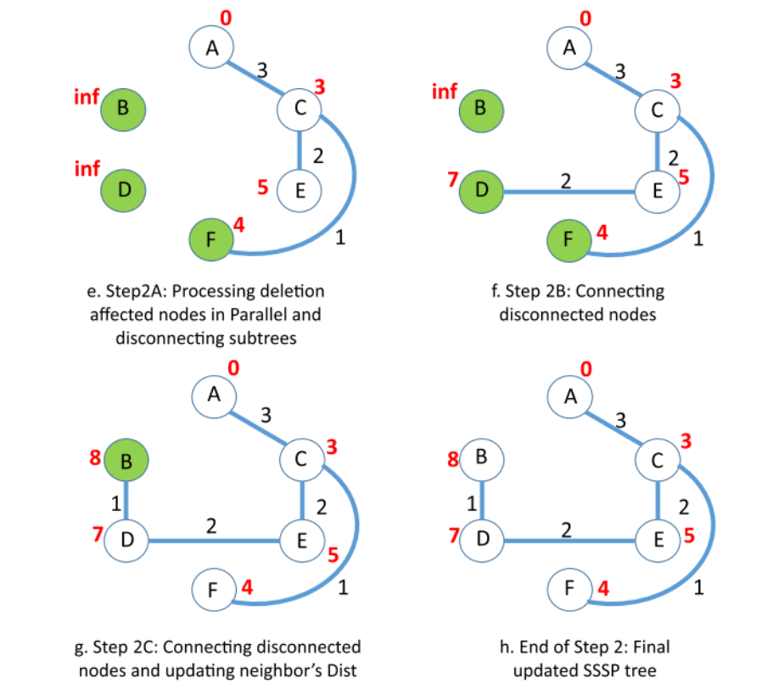

Slide 11
Update Affected Vertices
For Deletions:
Disconnect sub trees by setting Dist = ∞.
Iterative Updates:
Update distances using unaffected neighbors.
Cycle Prevention:
Process deletions first to avoid cycles.

Slide 12
Parallelization Strategy
The algorithm’s parallelism is key to its efficiency

Slide 13
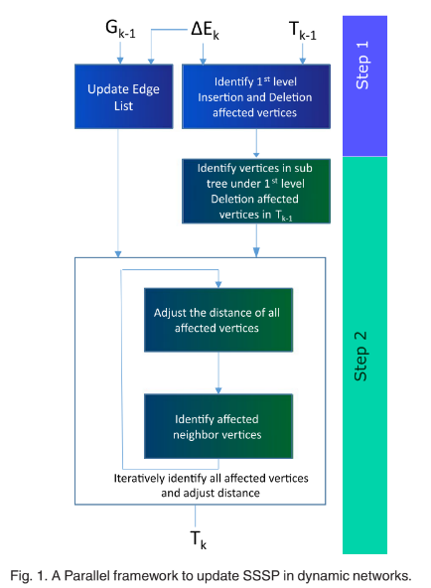
Algorithm Design
For GPU acceleration:
Minimize atomic operations.
Iterative Processing:
Disconnect and reconnect affected vertices.

Slide 14
Implementation
Graph Partitioning:
Use METIS to partition graph in subgraphs.
Assign subgraphs to nodes in Cluster
Inter-Node Communication:
Use MPI for Coordination between nodes.
Intra-Node Parallelism:
Use OpenMP within each node.
Use OpenCL for GPU acceleration.
Update Process:
Local updates for intra-partition changes
Coordinated updates for inter-partition changes between nodes.

Slide 15
Performance Results From Research Paper
GPU Performance vs Gunrock:
Up to 8.5x speedup (50M changes).
Up to 5.6x speedup (100M Changes).
Shared-Memory Performance vs Galoris :
Up to 5x speedup.
Effectiveness:
Best for >= 50% insertions.
Recompute if > 50% deletions.

Slide 16
Experimental Network Data
Networks Tested:
BHJ-1 : 1.8M vertices, 193M edges
BHJ-2 : 1.8M vertices, 202M edges
SOC-Orkut : 3M vertices, 106M edges
LiveJournal : 12.7M vertices, 161M edges
Graph500-scale23-ef16 : 4.6M vertices, 258M edges
RMAT24 G : 16.8M vertices, 134M edges

Slide 17
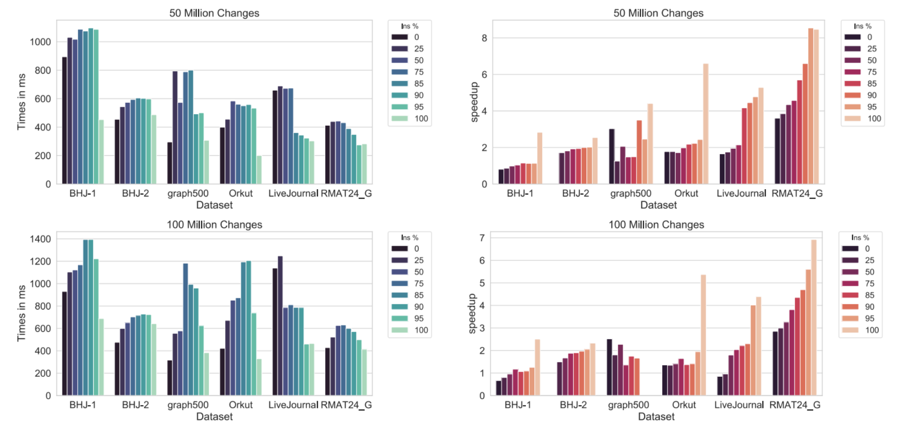

Slide 18
Challenges and Optimizations
Load Balancing :
Dynamic scheduling addresses uneven workloads, effective with lower overhead compared to static methods.
Synchronization :
Asynchronous updates reduce overhead, though they may increase the number of iterations, as seen in shared-memory experiments.
Cycle Formation :
Processing deletion-affected subtrees first, marking distances as infinity, prevents cycles, a critical aspect for maintaining correctness.

Slide 19
Conclusion
Contributions:
Scalable parallel framework for dynamic SSSP updates.
Efficient for large networks with frequent changes.
Demonstration on shared- memory and GPU
Future Work;
Extend to other graph algorithms.
Optimize for specific network types

Slide 20
Thank You

